Slide 1

Adolescent fertility in 12 INDEPTH sites in Sub-Saharan Africa: is change faster than envisioned?
C. Rossier, V. Delaunay, B. Schoumaker, D. Beguy, A. Jain, M. Bangha, M. Abera, G. Andargie, A. Aregay, B. Beck, K. Derra, M.Millogo, A.Nkhata, K. Siaka, M. Wamukoya, P. Zabre
Scientific day
"International comparisons at Ined"
30 September 2016, INED, Paris

Slide 2
The adolescent birth rate (ABR)
Indicator of progress towards maternal health
(MDGs and SDGs)
More recently: indicator of progress towards gender equity (see new Gender Inequality Index UN 2010): ABR tightly linked to poor education and early union formation / poverty
Indicator of adolescent overal sexual and reproductive health: associated with level of unmet need for contraception among adolescent
=> Contested (Hindin et al 2016): could unmet need not grow as ABR declines, depending on how it is measured (unmet need perhaps not well measured for non married women)

Slide 4
How accurate are the current measures of ABR in SSA?
In this paper, we investigate the question of the measurement of adolescent fertility rates in SSA
The main source of data on fertility in the region are the Demographic and Health Surveys (DHS)
We use here Health and Demographic Surveillance Systems (HDSS) data, which have contributed to the measure of mortality so far
sample sizes of adolescents in HDSS sites are much bigger than what is available in the DHS
data quality is expected to be better (age, missing births), and exempt of sampling biases.

Slide 5
Is unmet need really lower when ABR is lower?
Local-level data provide a larger diversity of situations
Local level analyses in a variety of contexts are needed to further our understanding of fertility change and implications of these changes
=> we will examine in particulat the relationship between ABR levels and measures of unmet need for different sub-groups of adolescents (married and not married according to different levels of sexual activity).

Slide 6
 | Starting year* | Population 2014 | Type | DHS year and region
Senegal |  |  |  | 2014
Bandafassi | 1970 | 13 000 | rural | Kedougou
Niakhar | 1962 | 43 000 | rural | Fatick
Mlomp | 1985 | 8 200 | urban | Ziguinchor
Burkina Faso |  |  |  | 2010
Nouna | 1992 | 93 000 | rural | Bouche de Mouhoun
Nanoro | 2009 | 54 780 | rural | Center West
Ouagdougou | 2009 | 82 387 | urban | Ouagadougou
Côte d’Ivoire |  |  |  | 2011-12
Taabo | 2008 | 45 766 | rural | Sur sans Abijan
Ethiopia |  |  |  | 2011
Dabat | 1996 | 46 984 | rural | Amhara
Gilgel Gibe | 2005 | 54 476 | rural | Oromya
Kilite | 2009 | 65 848 | rural | Tigray
Kenya |  |  |  | 2014
Nairobi | 2003 | 61 695 | urban | Nairobi
Malawi |  |  |  | 2010
Karonga | 2002-04 | 35 730 | rural | Northern

Slide 7
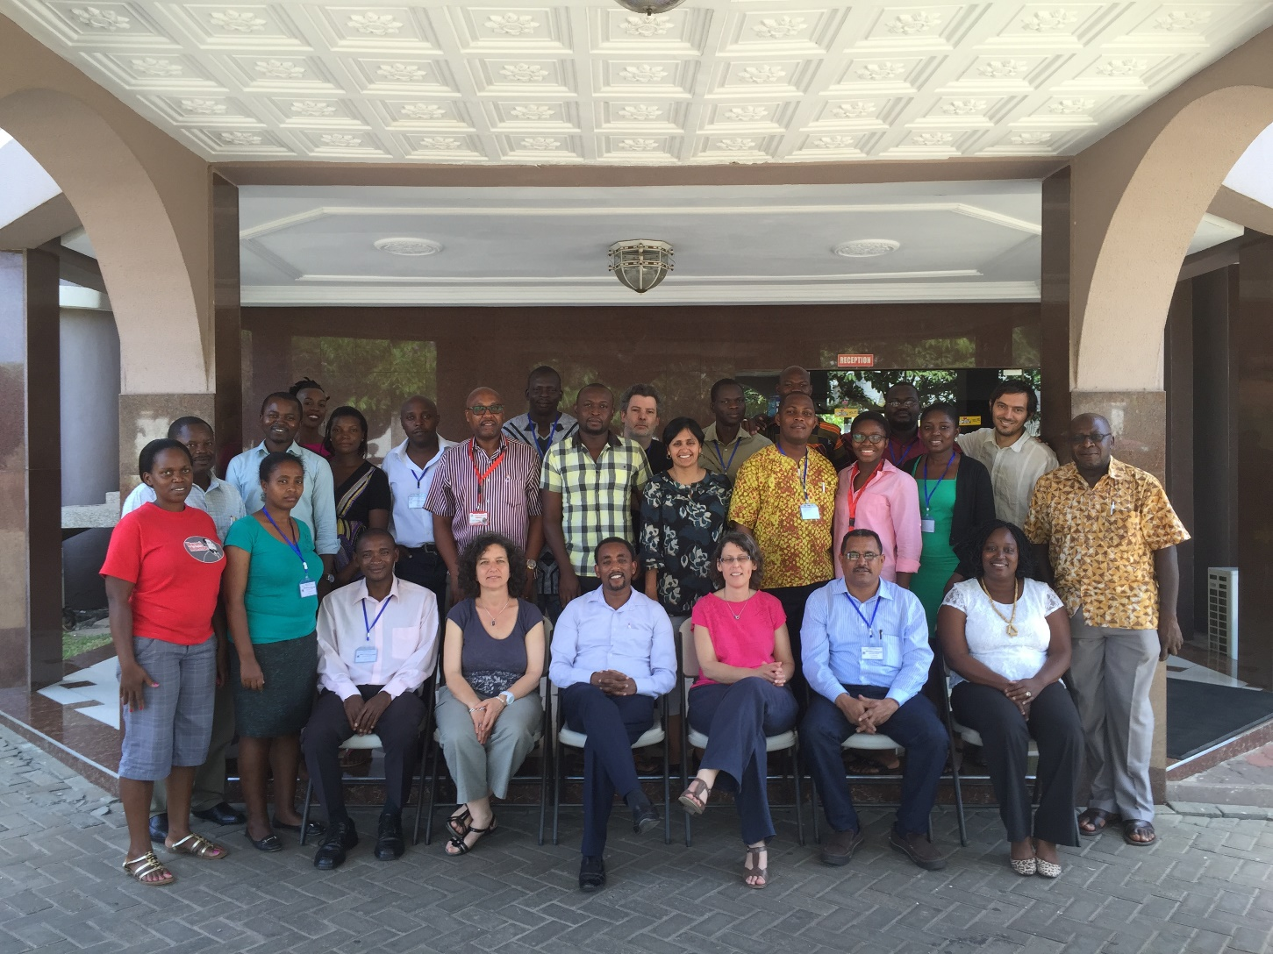
A workshop in Accra, May 2-6 2016

Slide 8
Comparative work at INDEPTH
Raising fundsto invite one researcher per site
Open call to all sites, template for data and examination of minimal data requirements
18 sites present in Accra
Most of the week devoted to construct the "core residency file" (done for INDEPTHStats, but not shared within sites)
12 sites completed the analyses after the workshop/ had sufficiently good data
=> No other data than fertility rates and current education…

Slide 9
Methods
HDSS : data in an event-history format: “core residency file” based on an entry/exit file of women aged 15 to 49, their date of birth and ID. Births and marriages (when available) were added as new events to the “core residency file”: data on education when available.
Three sites had no or incomplete data on recent educational attainment (Bandafassi, Mlomp, Nairobi).
DHS: we computed regional adolescent fertility rate for the 12 regions using tfr2 (5 last years); weights
We compared in the two sources of data ,
the ATB (matching years)
% population of women 15-19 by educational level (none, some primary, some secondary or more),
ratio of women aged 15 to 19 to women aged 15 to 49
- unmet need contraception, for different groups of w. 15-19 by marital status / sexual activity

Slide 11
A huge diversity: Mlomp at the level of Europe
Average for SSA 2010-2015 (UN): relatively close to the highest ABR registered among our sites (Nouna, Karonga, Bandafassi)
Very fast declines in some sites: Karonga, Taabo, Bandafassi

Slide 13
 | Number 15-19 |  | Ratio 15-19 to 15-49 |  | ABR |  |  | TFR
 | HDSS* 2014 | DHS Last survey | HDSS 2014 | DHS Last survey | HDSS Year of DHS last survey -1 | DHS (5 last years) | HDSS corrected DHS | HDSS Year of DHS last survey - | DHS (5 last years)
Bandafassi | 644 | 90 | 0.24 | 22.06 | 0.11 | 0.19 |  | 5.52 | 6.52
Niakhar | 2121 | 146 | 0.23 | 25.45 | 0.07 | 0.08 | 0.06 | 6.11 | 6.43
Mlomp | 476 | 103 | 0.23 | 22.97 | 0.02 | 0.08 |  | 3.50 | 4.66
Nouna | 3862 | 230 | 0.21 | 16.52 | 0.14 | 0.17 | 0.14 | 5.4730 | 6.77
Nanoro | 2229 | 304 | 0.19 | 0.13 | 0.09 | 0.13 | 0.07 | 4.8282 | 6.54
Ouagdougou | 4148 | 317 | 0.23 | 0.24 | 0.06 | 0.05 | 0.05 | 3.13 | 3.26
Taabo | 3851 | 137 | 0.21 | 0.20 | 0.14 | 0.13 | 0.10 | 5.3889 | 4.74
Nairobi | 2577 | 125 | 0.16 | 0.12 | 0.10 | 0.08 |  | 2.58 | 2.90
Karonga | 2387 | 968 | 0.21 | 0.23 | 0.14 | 0.17 | 0.07 | 5.3889 | 5.74

Slide 14
Comparison DHS- HDSS: 9 sites (Ethiopian sites forthcoming)
The ABR is lower in HDSS sited compared to DHS region in 5 cases, similar in 4 cases
Educational level of 15-19 on the whole lower in HDSS sites compared to region as a whole => when controlling for age, the gap widens
Similar conclusion for the TFR..
N much higher in HDSS
Does the DHS under sample "unconcerned" women aged 15-19?
=> ratio 15-19 lower in 3 sites (Nouna, Nanoro and Nairobi)

Slide 15
Context and consequences of ABR diversity among the 12 regions
(DHS data)

Slide 21
To sum up context / implications
Relationship with marital status and educational level as expected
Strong link with unmet need 15-19
No relationship with % engaging in premarital sexual activity
Strong link with unmet need among women 15-19 who are having premarital sexual activity
=> This unmet need seems related to contraceptive use / unmet need among married adolescent and not to how widespread premarital sexual activity is
Not enough data in the regional DHS samples

