Slide 1
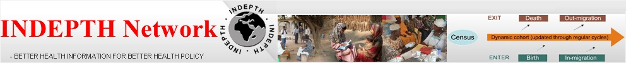

Adolescent Fertility Analysis and Developing Evidence for Advocacy
Martin Bangha & Clementine Rossier
(On behalf of INDEPTH Network WG on Fertility & SRH)
7th ANIE Annual Conference
Accra, Ghana, 5th October 2016
Notes:
1

Slide 2
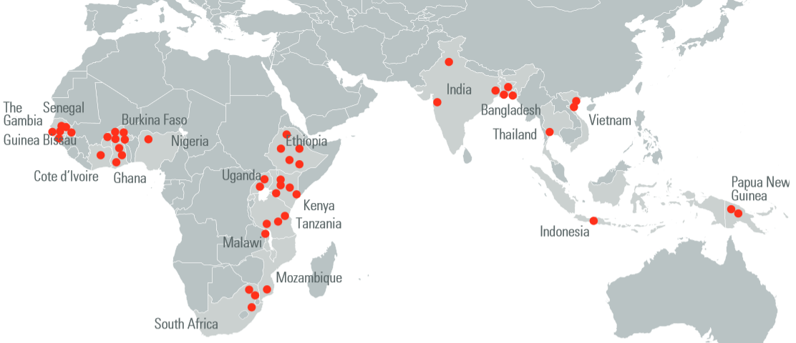
HDSS Sentinel Surveillance Countries
Over 3,800,000 people under continuous surveillance in INDEPTH Network
Ethiopia
Uganda
Kenya
Tanzania
Malawi
Mozambique
South Africa
Senegal
The Gambia
Guinea-Bissau
Burkina Faso
Cote d’Ivoire
Ghana
Nigeria
India
Bangladesh
Thailand
Vietnam
Indonesia
PNG
Notes:
2

Slide 3
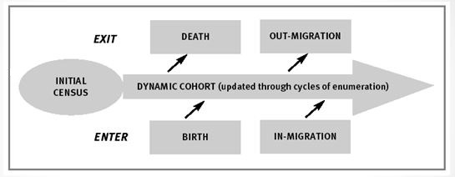
HDSS Data: Prospective Monitoring
Verbal autopsy for cause of death
RURAL - URBAN
Measure characteristics of environment or household members (e.g. SES, vaccines, HIV, nutrition)
Capturing episodes of disease and hospital admission; clinical, molecular-genomic level
Notes:
Underlying inspiration or drive for HDSS lies in the well known demographic accounting equation. That is the need to account accurately for the population exposed to the risk of any event. So the HDSS focuses on a well defined population and regularly monitors the in/out flows of persons to/from the group.

Slide 4
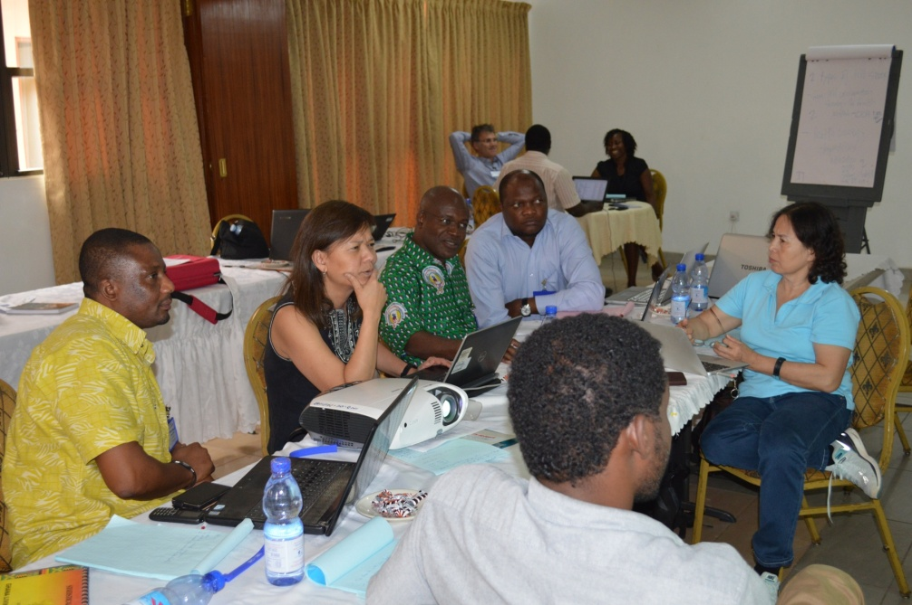
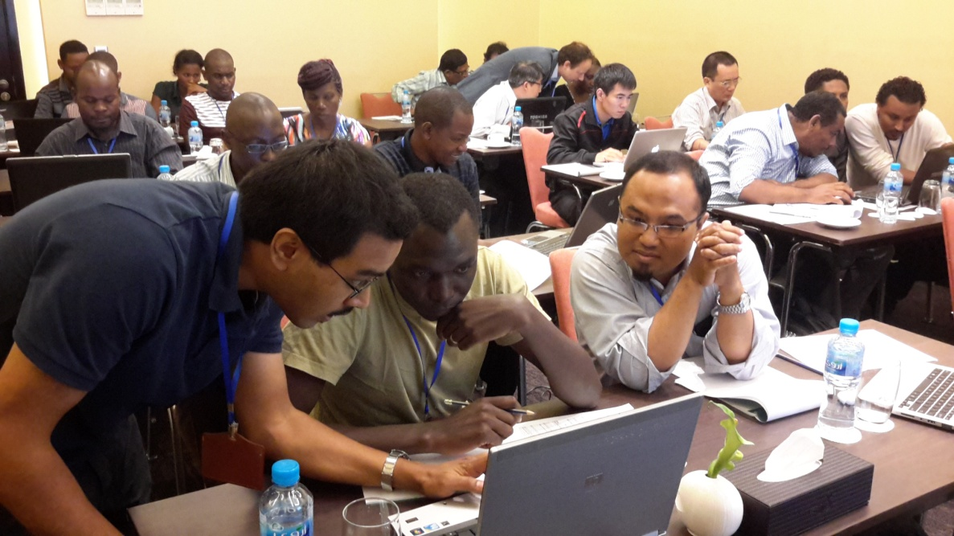
Active Working Groups → Projects
Adult health & Aging
Migration & urbanization
Vaccination & child survival
Antibiotics Resistance
Cause of death determination
  Environment & health
  Fertility - Sexual & Reproductive Health
  8. Health Systems
  9. Maternal & Newborn Health
  10. Social Science
  Education
  Research to Policy Group
Notes:
The working group strategy... Large projects are generated and funded

Slide 5
Leading the Fertility & SRH WG!
Co-leaders: Clémentine Rossier (U. Geneva) and Valérie Delaunay (IRD, Marseille)
Working group technical committee: Martin Bangha (INDEPTH), Donatien Beguy (APHRC), Jacques Emina (U Kinshasa), Bruno Schoumaker (UCL), Abdramane Soura (ISSP)

Slide 6
Major Undertaking of Fertility & SRH WG
June 2014: fertility workshop with sites in Burkina Faso → Takes time to organize data for analysis
2014: 5000$ by INDEPTH to study fertility using INDEPTHStats; paper written and presented at the PAA 2015 and ISC 2015.
WG launched at the ISC in Addis Ababa, November 2015: interest expressed by member centres
SARECO funding (Switzerland), Evidence project (PopCouncil/USAID), Ined and INDEPTH
1st workshop on adolescent fertility held May 2016

Slide 7
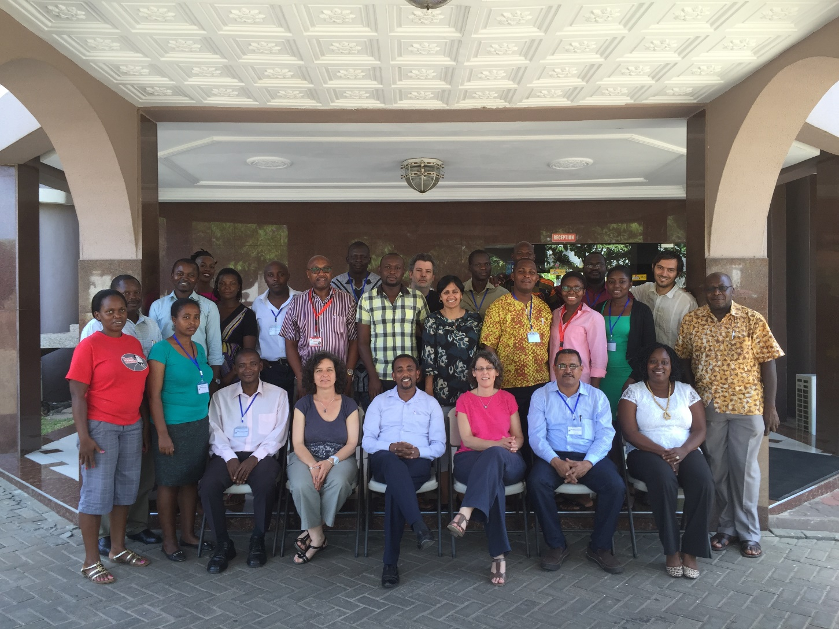
Participants at workshop in Accra, May 2-6 2016
Some 29 participants
18 HDSSs represented from 8 African countries; West & East equally
Population covered: ~1.2 million: from 8,500 (Mlomp) to 160,000 (Navrongo)
TFR: ranging from replacement level (Nairobi) to ~6 for Kyamulibwa, Karonga & Niakhar

Slide 8
Objectives of workshop/project
Compile/review data from member HDSS centres & gain insight on the research conducted on fertility
Harmonize and prepare the relevant datasets for comparative analysis of adolescent fertility: 3 topics
  Contribution of adolescent fertility to overall TFR
  Increasing education for girls and adolescent fertility
  Socioeconomic conditions and premarital fertility
Eventually, disseminate the findings in order to enhance uptake and use in policy and RH programme implementation.

Slide 9
General Observations from Workshop
Workshop served to capitalize on the interest in fertility and SRH in the centres and to strengthen capacity on reproductive health issues by having them explore the use of existing data.
In general, a lot of capacity strengthening was done through the data harmonization & data management
Urgent need for a few key questions on reproductive health issues and contraceptive use to be added to the routine HDSS data collection, to prepare the centres for the monitoring and evaluation of programs in this area.

Slide 10
Project Experience & Accomplishments - 1
So far, 12 of the 18 HDSSs produced acceptable results and are considered in the ongoing comparative analysis
Collaboration with the Evidence Project Communication Team has produced an article on the workshop that was published on the Evidence Project website
Work presented at recent INDEPTH strategic planning meeting held recently in Johannesburg, South Africa (August 2016).
Abstract prepared and submitted for the PAA Annual Meetings schedule for Chicago, USA, April 27-29, 2017

Slide 12
Notes:
On the whole, adolesecnt birth rates is lower in HDSS sites and declines faster than national /regional averages /trends; large diversity

Slide 13
Adolescent birth rate in 6 INDEPTH HDSS sites (standardized on educational levels of the region), sub-saharan Africa, compared to ABR level in the region according to the last DHS survey
Notes:
The data seems to indicate that ABR are overestimated in DHS

Slide 14
Concluding Remarks
As noted there is urgent need for key RH and FP questions to be added to the routine HDSS data collection (for example: parity but also contraceptive prevalence) , to prepare the centres for the monitoring and evaluation of programs in this area.
Also for most participating HDSSs, level of education is not routinely collected as well as other basic socio eco variables (in particular urban / rural) and so it is difficult to fully explore some of the anticipated analysis
Funds are definitely needed to facilitate the design of and assist centres to implement such a new module
Funds also needed to organize another workshop to extend coverage of this analysis to other HDSSs

Slide 15
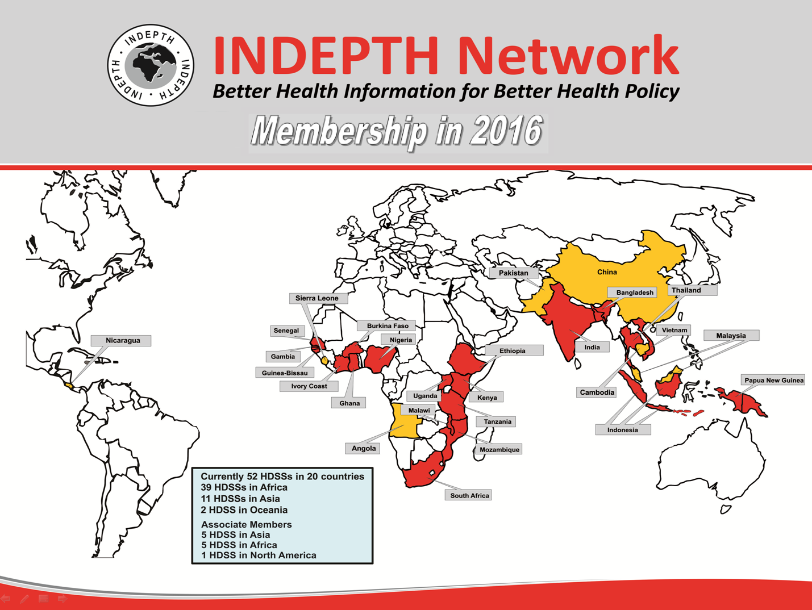
Potential HDSSs expected…
Cameroon, DRC, Gabon, Liberia, Mali, Niger, Rwanda
Over 3,800,000 people under surveillance
Notes:
Countries where INDEPTH member HDSSs currently are, and potential expansion

